Slide 1

Integrated Project-I
(CS203)
PROJECT REPORT
on
Machine Learning Models in Financial Implementations
BATCH-2022
Student Name & ID
Project Mentor
1.Shreyash(2211981379)
2.Saksham(2211981335)
3.Karan(2211981190)
4.Kartik(2211981192)

Slide 2

Sustainable Development Goals

Slide 3
1. Title of Project: Machine Learning Models in Financial Implementations
2. Description:
Analysis involves preparing and selecting relevant features, training models with historical data, validating predictions on separate datasets, and assessing metrics like accuracy and risk management
3. Objectives:
To implement various machine learning models for short term stock predictions. The models to be implemented are RNN, LSTM
To compare the performance of the above models in stock prediction
4. Key Learning:
Understanding the concept of Machine Learning
Implementation of Machine Learning in financial sector

Slide 4
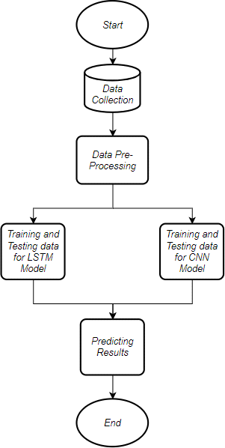
Methodology:
It contains a detailed listing of process and code implementation and then the whole stage wise explaining of the implementation of code using the algorithms. It is a depiction of the proposed model used in this work.
A Proposed Model.

Slide 5
There are numerous amounts of sources present on the internet to collect historical data of stocks. For this paper, a very trusted and liable source is used that has actual historical stock data of many companies. For this paper, the dataset of the yahoo finance is used with data ranging from 01/01/2015 to 31/12/2023.
6. Individual Roles:
Project Manager: Oversaw planning, coordination and team communication.
Data Scientist: Cleans, preprocesses, and analyzes financial data. Machine Learning Engineer: Works on model scalability, efficiency and integration into production systems.
Communication Specialist: Develops documentation for models, algorithms, and processes.

Slide 6
Timeline showing weekly progress (For 15 weeks):
Week | Task
1. | Study of Machine Learning
2. | Data Collection
3-4 | Data Implementation
5-10 | Report
11-14 | Research Paper Preparation
15 | Communication of Research Paper to conference

